Slide 1
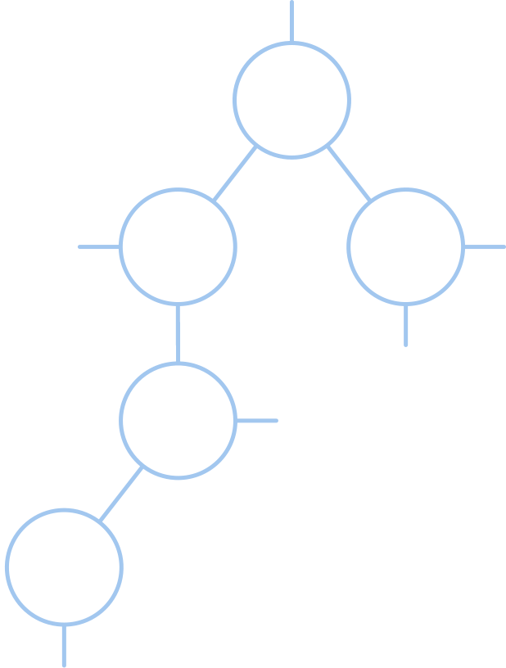
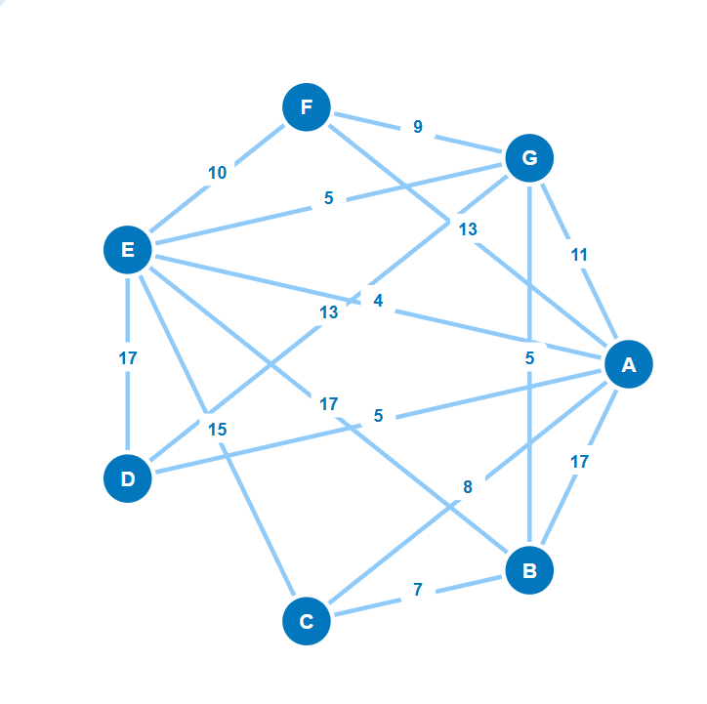


CSC-520 : Practical 1
MST Visualizer
Interactive Minimum Spanning Tree Algorithm Visualizer
Kruskal's & Prim's Algorithms
Group No. 7
Abhishek Jaiswar - 256201
Yogiraj Bhilare - 256228
Tejas Patare - 256259
Notes:
1

Slide 2
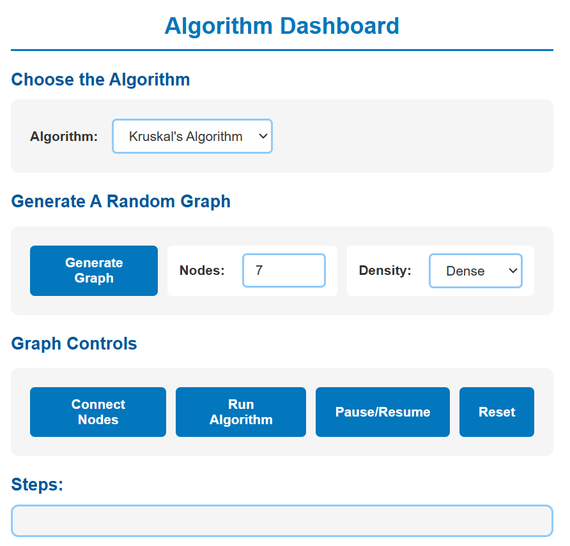
Case Study Description
Problem
Students struggle to understand abstract graph algorithms without visual representation and step-by-step execution flow.
Solution
An interactive web-based visualizer that demonstrates Minimum Spanning Tree algorithms through real-time visual feedback.
Project Scope
Technology: Vanilla JavaScript (ES6), SVG, CSS3
Algorithms: Kruskal's & Prim's MST algorithms
Features: Interactive graph creation, random generation, step-by-step visualization, execution control
Use Cases
Educational tool for Data Structures courses
Algorithm comparison and analysis
Understanding greedy algorithm approaches
Learning graph theory concepts
Group No. 7 2
Notes:
2

Slide 3
Modular Project Structure
Clean separation of concerns across three architectural layers ensures maintainability, scalability, and efficient code organization.
UI Layer
Logic Layer
Algorithm Layer
  index.html
  style.css
  dom.js
  graphDrawing.js
  modal.js
  state.js
  interactions.js
  graphGeneration.js
  utils.js
  algorithms.js
  uiControls.js
Separation of Concerns
Maintainable Code
Scalable Design
Group No. 7 3

Slide 4
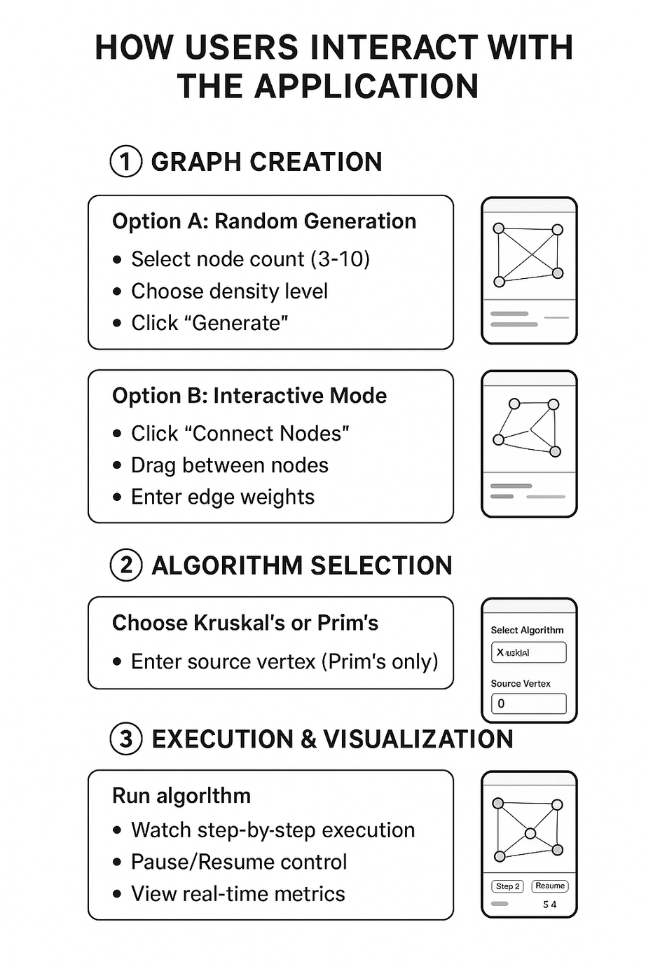
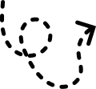
User Interaction Flow
01
02
Create Graph
Select Algorithm
Choose between random generation (select node count and density) or interactive mode (drag nodes to connect and set edge weights).
Pick Kruskal's or Prim's algorithm. For Prim's, specify your source vertex to begin tree construction.
03
Visualize Execution
Run the algorithm step-by-step with pause/resume control. Monitor real-time metrics, edge selections, and tree growth as the algorithm progresses.
Group No. 7 4

Slide 5
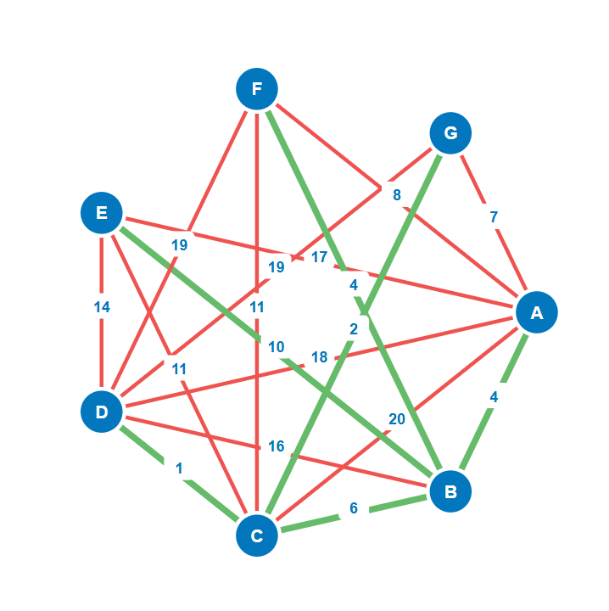
Kruskal's Algorithm
Algorithm Approach
Edge-based greedy algorithm that builds MST by selecting edges in ascending order of weight.
Union-Find Data Structure
Algorithm Steps:
  find(x): Locates set with path compression
Sort all edges by weight: O(E log E)
Initialize parent array (each node is its own parent)
For each edge (u, v, weight):
  a. If find(u) ≠ find(v):
  • Add edge to MST (mark GREEN)
  • union(u, v)
  b. Else:
  • Skip edge - creates cycle (mark RED)
  4. Stop when MST has (V-1) edges
  union(a,b): Connects two disjoint sets
Complexity Analysis
  Time: O(E log E)
  Space: O(V)
  Best For: Sparse graphs with fewer edges
Group No. 7 5
Notes:
5

Slide 6
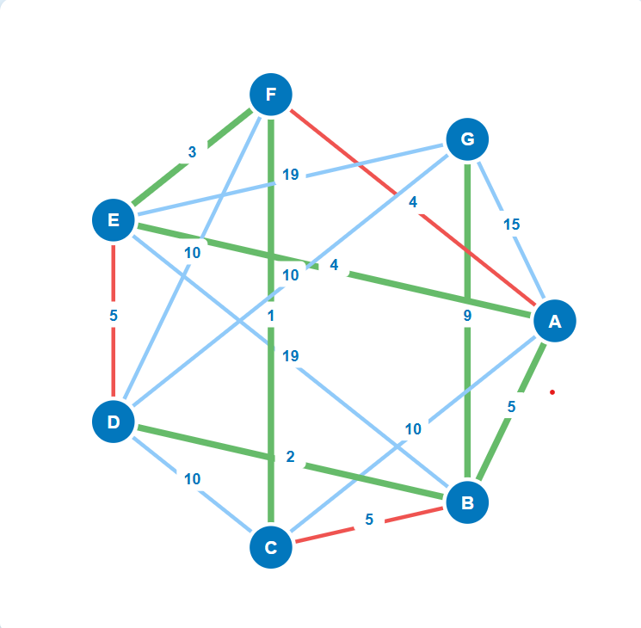
Prim's Algorithm
Algorithm Approach
Priority Queue Structure
Vertex-based greedy algorithm that grows MST from a source vertex by selecting minimum weight edges to unvisited vertices.
  Maintains available edges efficiently
Algorithm Steps:
  Sorted by edge weight
  Enables quick minimum selection
Select source vertex, add to visited set
Add all edges from source to edgesAvailable
While visited.size < V:
  a. Sort edgesAvailable by weight
  b. Extract minimum edge (u, v)
  c. If both u,v in visited:
  • Skip edge (mark RED)
  d. Else:
  • Add edge to MST (mark GREEN)
  • Add new vertex to visited
  • Add its edges to edgesAvailable
  4. MST complete when all vertices visited
Complexity Analysis
  Time: O(E log V)
  Space: O(V)
  Best For: Dense graphs with many edges
Group No. 7 6
Notes:
6

Slide 7
USER INTERFACE DESIGN
Design Philosophy
Graph Area
Control Panel
Students struggle to understand abstract graph algorithms without visual representation and step-by-step execution flow.
  Nodes
  Edges
  Weights
  Visual Feedback
  Algorithm Selector
  Graph Gen
  Controls
  Step Logger
Key UI Components
Graph Visualization (SVG)
• Nodes: Circular (18px radius), blue (#0277bd)
• Edges: Lines with weight labels
• Color Coding: Green (accepted), Red (rejected)
• Interactive: Drag-and-drop edge creation
2. Control Panel
• Algorithm Dropdown: Kruskal's / Prim's
• Graph Generation: Random (3-10 nodes, density)
• Execution Controls: Run, Pause/Resume, Reset
• Real-time Step Display: Scrollable text area
3. Modal Dialog
• Weight Input: Appears on edge creation
• Validation: Positive integers only
• User Feedback: Error messages
Responsive Features
✓ Split-panel layout (50-50)
✓ Smooth transitions and hover effects
✓ Color-coded feedback (visual + text)
✓ Auto-scroll for step display
Group No. 7 7
Notes:
3

Slide 8
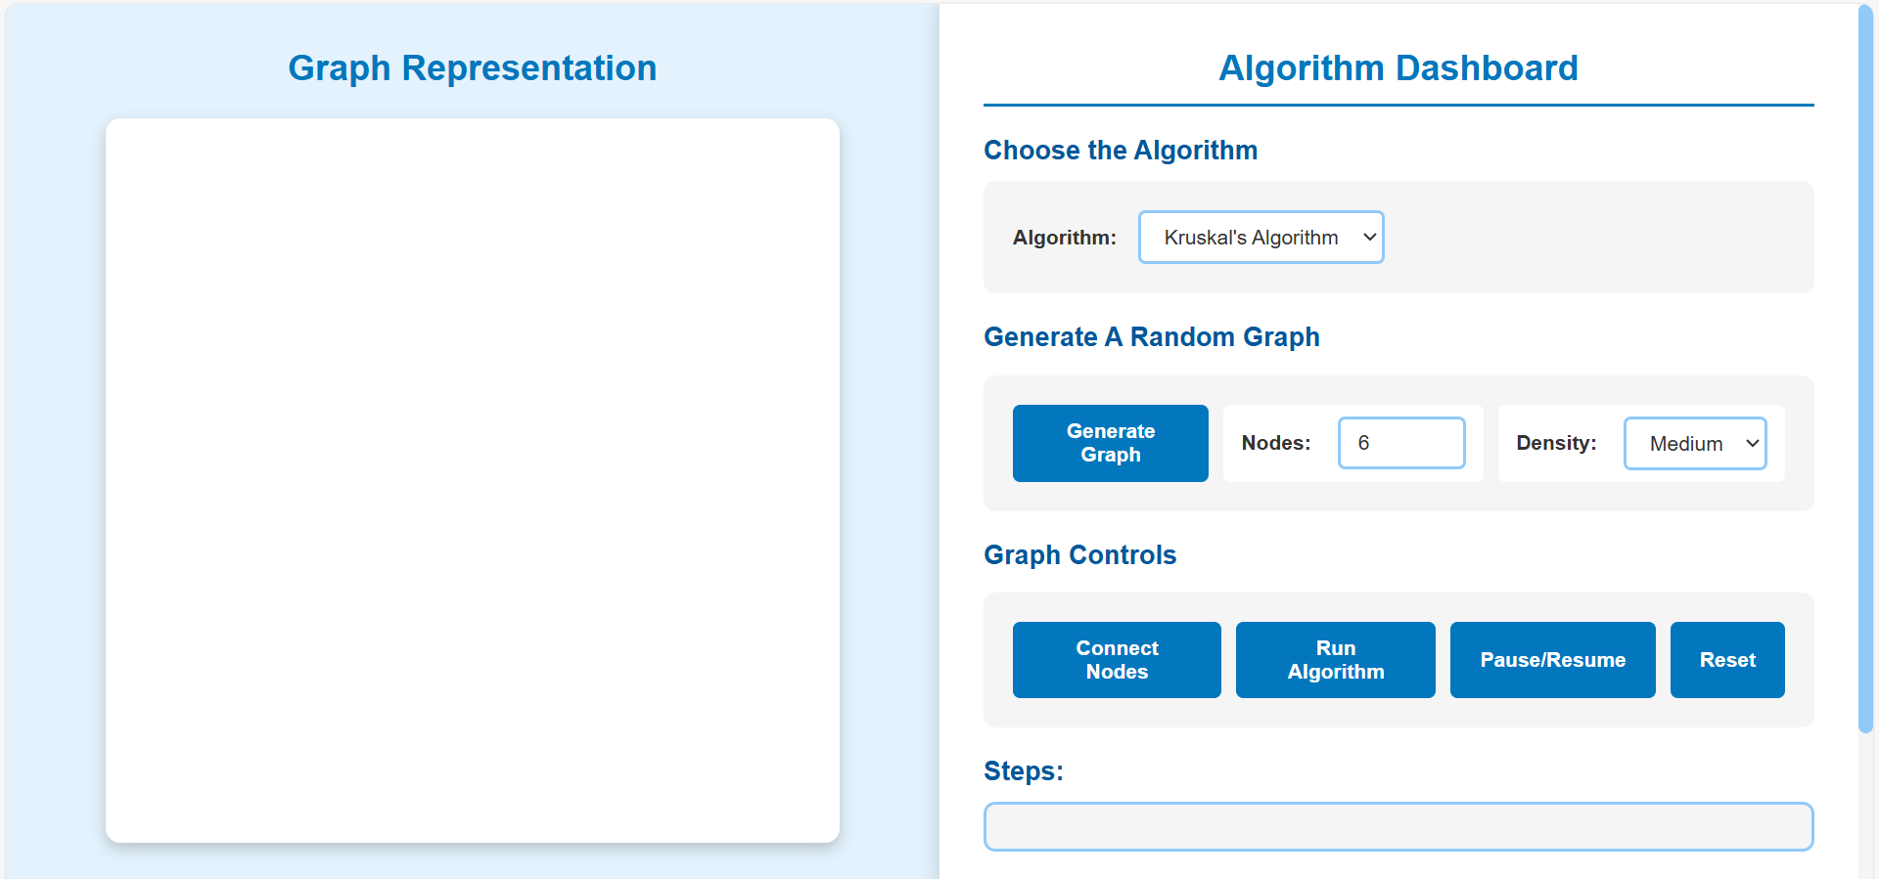
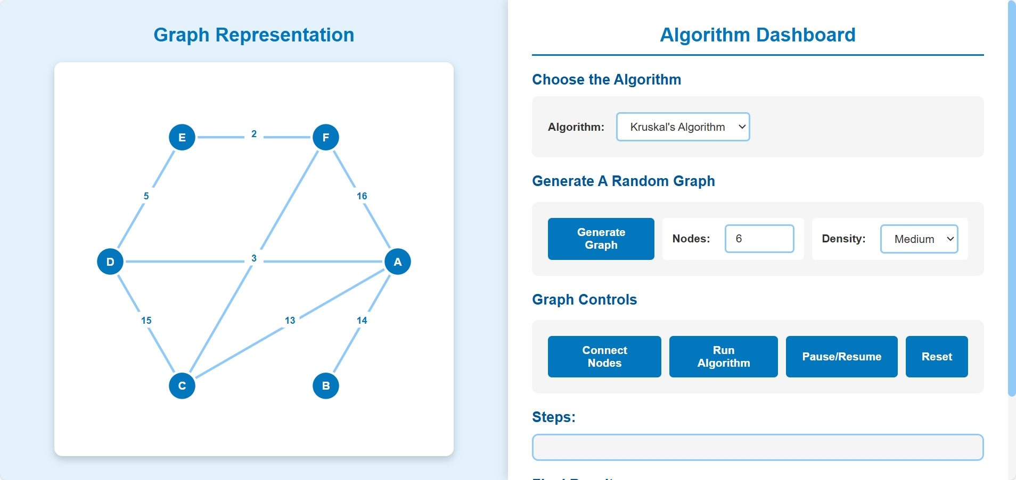
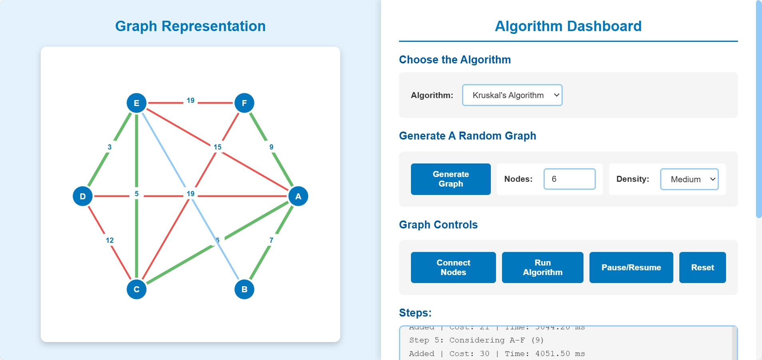
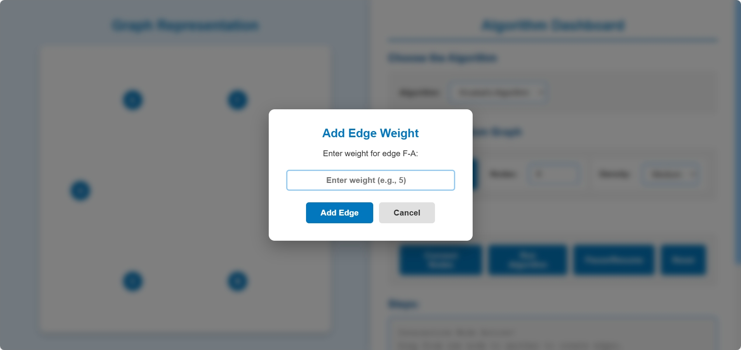
SCREENSHOTS
Clean dashboard with algorithm selector and controls
6-node medium density graph with weighted edges
Step-by-step execution showing accepted (green) and rejected (red) edges with real-time logging
Drag-and-drop edge creation with weight input modal
Group No. 7 8
Notes:
4

Slide 9
Key Achievements
References
✅ Successfully implemented two MST algorithms with visualization
✅ Modular ES6 architecture with 9 separate modules
✅ Interactive graph creation with drag-and-drop
✅ Real-time step-by-step algorithm execution
✅ No external dependencies - pure vanilla JavaScript
📚 Algorithm Resources:
[1] Cormen, T. H., et al. (2009). "Introduction to Algorithms" (3rd ed.). MIT Press. Chapter 23: Minimum Spanning Trees.
[2] Sedgewick, R., & Wayne, K. (2011). "Algorithms" (4th ed.). Addison-Wesley. Section 4.3: Minimum Spanning Trees.
🌐 Web Technologies:
[3] MDN Web Docs - SVG Documentation https://developer.mozilla.org/en-US/docs/Web/SVG
[4] MDN Web Docs - ES6 Modules https://developer.mozilla.org/en-US/docs/Web/JavaScript/Guide/Modules
🎨 Design Inspiration:
[5] VisuAlgo - Algorithm Visualizations https://visualgo.net/en/mst
[6] D3.js Graph Visualization Examples https://d3js.org/
Technical Metrics
Lines of Code: ~500
Modules: 9 (state, DOM, drawing, interactions, algorithms, etc.)
Algorithms: 2 (Kruskal's & Prim's)
Time Complexity: O(E log E) and O(E log V)
Thank You!
Group No. 7
Notes:
8

